Slide 1
Web Development HTML and CSS

Slide 2
How the Internet works

Slide 3
After completing this module you will be able to describe:
The fundamentals of how the internet works
How the World Wide Web came about
How information is sent through the web
What is HTTP, TCP/IP and IP addresses
What ports are used for
The use of client-side and server-side processing
As well as Get and Put verbs
The use of Cookies
Objectives

Slide 4
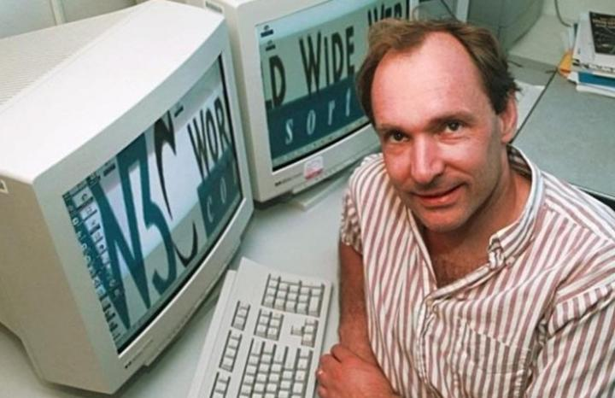
What is The World Wide Web (WWW)
What is WWW, When it was invented, Who created it?
Proposed by physicist Sir Tim Berners-Lee in 1980
In 1989, he published a paper called 'Information Management: A Proposal' in which he used hypertext with the Internet to create a system for sharing and distributing information not just within a company, but globally
He named it the World Wide Web
Wrote a browser and server software in 1990

Slide 5

What is the internet?
The World Wide Web (WWW) or the Web is not the same as Internet
Conceived by the Advanced Research Projects Agency of the U.S. government in 1969 and was called ARPANET
Worldwide system of computer networks
Is a way of accessing information over the Internet
Any computer can get information from any other computer
Uses a set of protocols called TCP/IP
Transmission Control Protocol/Internet Protocol
No one owns it or controls it
5

Slide 6
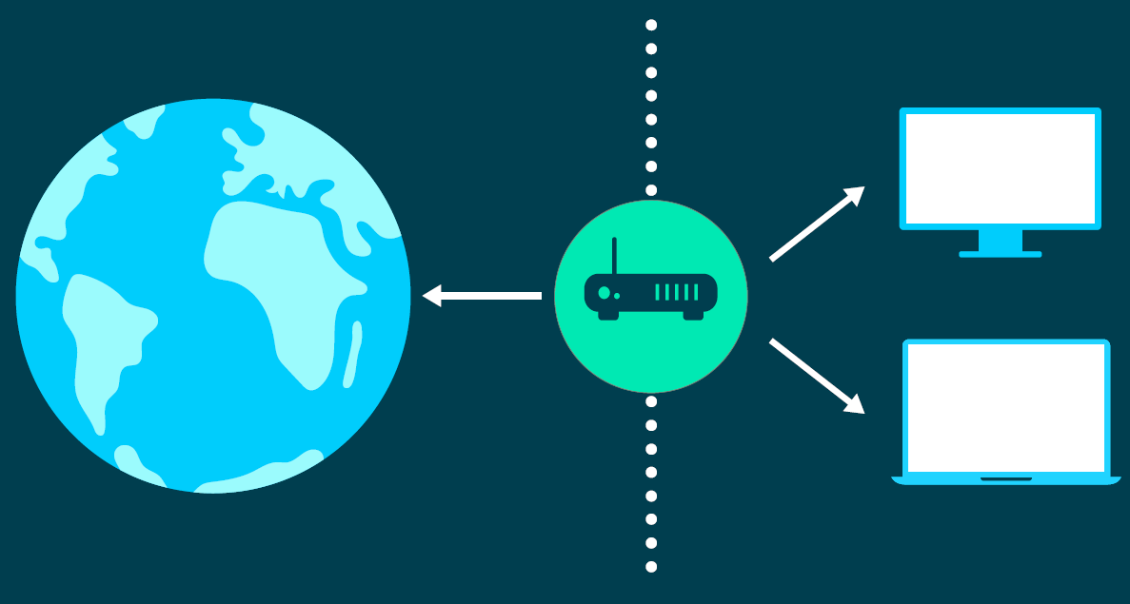
What are IP addresses?
IP address (Internet Protocol address)
IP is a Packet-forwarding protocol
Each connected device uses an IP address to identify itself. Like your postcode and door number.
Is a set of numbers that might look like: 198.167.55.12
IPv4 is an Internet protocol used to connect devices
32bit address scheme = 4.3 billion addresses.
We are running out of addresses!
IPv6 (next generation Internet standards)
Uses a 128 bit address scheme.
Can address 2000 devices for every square inch of our planet!
Provides technological changes too
IPv6 and IPv4 run alongside each other
6
Notes:
The core protocol of the TCP/IP protocol suite is IP, the Internet Protocol.
IP is a connectionless, datagram-oriented packet-forwarding protocol. Data is passed to IP from higher-level transport protocols for delivery. IP sends a packet on the next stage of its journey to its ultimate destination, based on the destination IP address and routing information that is held internally within the protocol. An IP packet may pass through several routers, or "hops" before reaching its destination.
An Internet address in IPv4 is a 32-bit unsigned integer value (4 Giga). A typical example is shown in the slide. The value has a component that describes the network address and one that describes the address of the individual host on that network. Details of how these components are included in the address are described later.
This type of value is often difficult to remember and to use in dealing with the network. Even if the binary representation is converted straight to decimal, or hexadecimal, the result is a large and unwieldy number. Moreover, it is not easy to distinguish the network address component from the host address component using this single value representation.
For these reasons, Internet addresses are usually described in a notation known as "dotted decimal". The four bytes (or "octets") that make up the 32-bit word are each translated into decimal numbers, in isolation. The result is a sequence of four decimal numbers, separated by dots.
IP version 6, also known as IP next generation (IPng), is the successor to the current Internet Protocol (version 4). RFC 2460 is the main standard, many other RFCs cover related issues. The new features within IPv6 are designed to overcome the current problems within today’s Internet protocol. The major enhancements are summarised as follows:
IPv6 has significantly larger addressing capabilities over current IP. The original 32-bit address field has been expanded to 128 bits. This theoretically means there could be a total of 340,282,366,920,938,463,463,374,607,431,768,211,456 devices connected to the Internet under IPv6. Which works out to be 665,570,793,348,866,943,898,599 addresses per square meter of the earth's surface.
Support for authentication and privacy has also been incorporated using digital signature technology. Auto configuration protocols such as Microsoft’s DHCP (discussed later) are also directly supported.
All new Internet standards must now include support for IPv6. As yet, it is uncertain when the transition from IPv4 to IPv6 will be complete, if ever. However, as IPv6 is fully backwardly compatible with existing Internet protocols, systems that are not upgraded should experience no loss of functionality.
Virtually all manufacturers include IPv6 support in their products, and all major operating systems have IPv6 support, or can have it retrofitted.

Slide 7
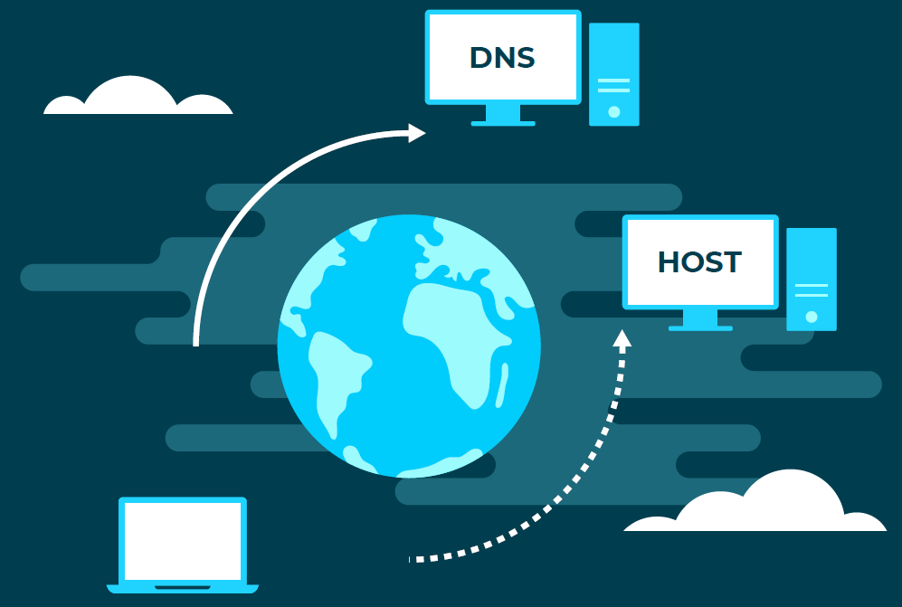
What is DNS?
DNS
Stands for Domain Name Servers
Is the Internet's equivalent of a phone book.
They maintain a directory of domain names and their IP addresses
They translate a domain name like www.qa.com into an IP address
How
In the first place your computer looks in its local DNS cache. This may be stored on your computer’s recently visited sites.
Eventually your request gets to a network of server to find the address
If you register a new domain name or update an existing one it takes about 12-36 hours for the DNS world-wide to be updated.
7

Slide 8
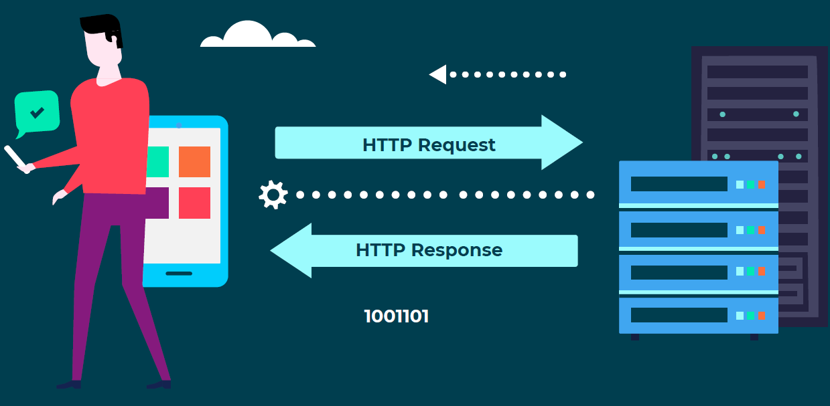
What is HTTP?
Hypertext Transfer Protocol is a network protocol used to deliver data
Data can be HTML files, images, query results. These are resources
A browser is an HTTP client because
It sends requests to an HTTP server (Web server),
Gets a response back to the client.
HTTP is Stateless and a very thin protocol
Request and Response have a Header, Body
Response Codes indicate if a request is successfully completed
codes (200, 404, 500)…
8

Slide 9
What is TCP/IP?
Transmission Control Protocol / Internet Protocol
Two of a family of protocols
Also known as the "Internet Protocols"
Stack of protocols from the network layer (OSI layer 3) upwards
TCP and IP were most widely used originally
Others include:
User Datagram Protocol (UDP)
File Transfer Protocol (FTP)
Simple Mail Transfer Protocol (SMTP)
These protocols form the basis of the Internet
Notes:
The acronym TCP/IP stands for the initials of two protocols, the Transmission Control Protocol and the Internet Protocol. These are just two members of the family of protocols known as the Internet Protocols.
However, in early usage the most common were TCP, which stands for Transmission Control Protocol, and IP, which stands for Internet Protocol. Hence, the acronym TCP/IP is commonly used to refer to the whole family of protocols. In reality there are over twenty protocols in the suite, covering all aspects of network usage and management. Some of the other protocols defined within the suite are:-
File Transfer Protocol Exchange files between hosts
Simple Mail Transfer Protocol Send electronic mail
Domain Name Service Convert names to addresses
Network File System Remote file system sharing
Hyper Text Transfer Protocol Basis of the World Wide Web

Slide 10
Each process uses a different port:
Ports in Action
FTP
HTTP
SMTP
Port Number :
21
80
25
TCP / UDP
IP
Notes:
IP delivers packets to a particular host and passes them up to TCP( or UDP). These protocols in turn inspect the port number in the header and use this to determine which process the data is intended for.
Some processes use “well-known addresses”, or predetermined port numbers, which enable a remote client to easily locate them. For example, the FTP server process (“daemon” on UNIX or service on NT) always receives data on port 21; the http process used by World Wide Web servers listens on port 80; and so on. The list of standard addresses is continually being added to and is defined in the latest version of the Assigned Numbers RFC (e.g. RFC1010). Many TCP/IP implementations store this information in a file called services.
Other processes will use port addresses, which are assigned dynamically. For example, a Telnet client will connect to a Telnet server somewhere. The Telnet server needs a well-known address so that the client can connect to it. However, the client is not expecting to receive data from anyone that it has not spoken to first and so can choose a port to use at random. When it connects to a Telnet server, the first message it sends will include the port address that it is currently using.

Slide 11
URL Syntax
Scheme (How)
Path (Where: scheme-specific format)
Resource (What)
http://www.microsoft.com/ie/page.html
ftp://ftp.demon.co.uk
news:comp.infosys.www.announce
mailto:billg@microsoft.com
www.bbc.co.uk
This is not a valid URL, but many browsers accept
it as equivalent to http://www.bbc.co.uk
Notes:
A URL is divided into two parts separated by a colon. The basic syntax is:
Scheme:Path
The scheme specifies the protocol to be used to retrieve the document (e.g. ftp, http, gopher) and the path specifies the location of the server and the resource. The path format is dependent on the scheme used.
Some examples of valid URLs
http://www.microsoft.com/ie ftp://ftp.demon.co.uk news:comp.infosys.www.announce mailto:billg@microsoft.com
Text strings without a scheme, such as www.bbc.co.uk, are not really valid URLs because the scheme is required. However, most browsers will accept such URLs if they are typed in by the user and will assume a scheme of http these cases.

Slide 12
HTTP URL Format
Host name
Port number. Defaults to 80.
http://www.microsoft.com/ie
http://www.microsoft.com:80/ie
http://www.carousel.org/galloper/april.html
http://www.qa.com
Document path. May be case-sensitive
An empty path refers to the home page
(server-dependent: may be index.html or default.html)
Notes:
The Web uses HTTP to retrieve documents, the URL format is:
http://Hostname[:Port]/Document-Path
The hostname is the textual name of the machine on the internet or Intranet. This name is usually resolved by a domain name server (DNS) into a numeric address. Numeric addresses can be used although this is less flexible as it doesn’t allow the server’s address to be changed without changing all the URLs which reference it.
Hostnames often begin with www although this is by no means essential. It’s just a convention which many sites adhere to.
The host name can be followed by a colon and a port number. Web servers normally use the “well-known” HTTP port number 80. This is the default value if no port is specified. A common alternative port number is 443, which is used by several security systems. Port number 8080 is another popular alternative as it allows a normal Unix users (not the administrator) to run a Web server.
The document path is the location of the resource under the Web server’s directory tree, the root of which may differ from that on the local machine. Posix (Unix) backslash characters are used as directory separators and the names are case-sensitive where this is important to the server’s file-system. Unix servers have case-sensitive file servers but Windows NT server’s don’t.
If the document path is omitted the URL is taken to refer to the home page for that site. The home page is very server-dependent and configuration-dependent, but often refers to a file such as index.html or default.html.

Slide 13
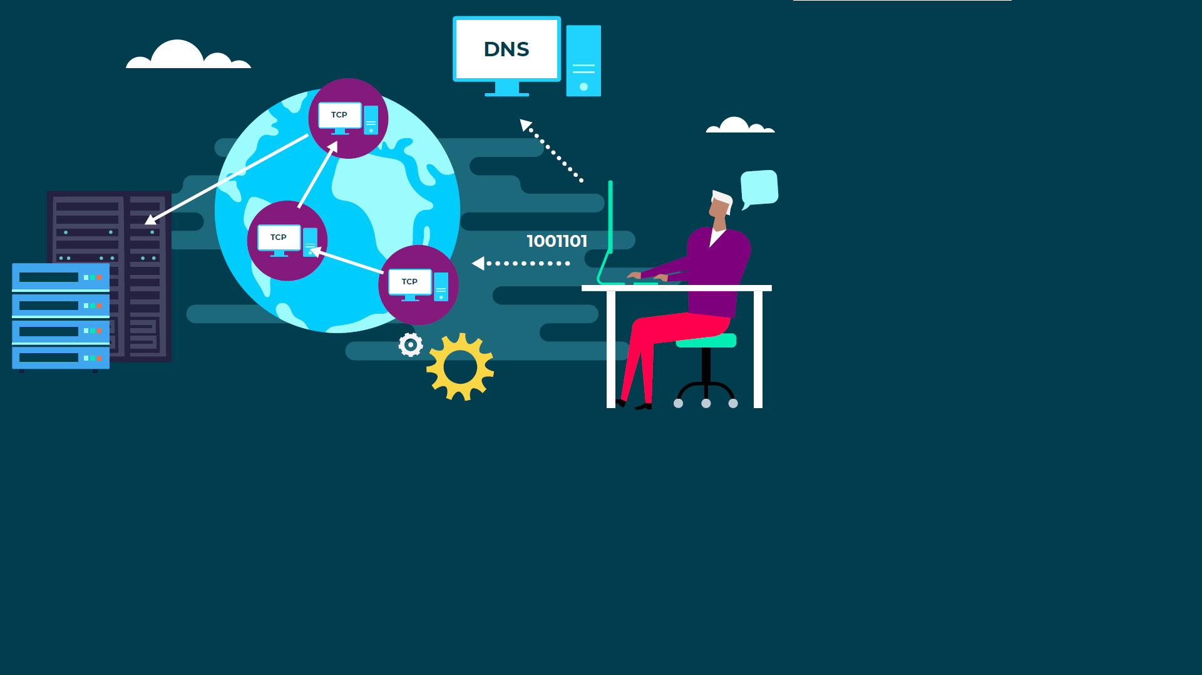
Principles of Browser Operation
Notes:
Given a URL such as:
http://www.qa.com/index.html
The browser first contacts a domain name server (DNS) to resolve the hostname into a numeric IP address.
The browser will then attempt to open a TCP connection to the remote server. Internet packets will travel through many gateways to reach the server. For example, between a client in the UK and a server situated on the western US seaboard there may be a dozen intermediate networks. Fortunately, this is transparent to the browser software and to the user.
Once the connection is established the browser will send the name of the resource it requires; the Web server will return this document. The connection will then be closed and the browser will parse and display the retrieved HTML file. This retrieval processes is repeated for every reference to an image contained within the document. Small wonder that many modem-based users turn off automatic image loading.
The World Wide Web puts a heavy load on the Internet. A whole series of operations are required to retrieve even a simple document. An HTML document will consist of some text and may contain references to images. Indeed it was the image extensions introduced by Bina and Andreessen which lead to ‘death of the net’ worries and earned them disfavour from their NCSA colleagues.

Slide 14
HyperText Transfer Protocol (HTTP)
HTTP is an Application Level Protocol
Simple – has a Request and Response (header & body)
Stateless – each request is independent from the others
HTTP Request
GET /folder/page.html HTTP/1.0 User-agent: Mozilla/4.0
HTTP Response
HTTP/1.0 200 OK Server: Microsoft-IIS/5.0 Content-Length: 6821 Content-Type: text/html
data data data ...
Notes:
HTTP is stateless. This means that each request for a resource from the Web server, such as that for an HTML page, is seen as being completely independent of any previous request.
The Web server doesn’t store any information that associates the different requests, which in turn means that the Web server can scale well to deliver extremely large numbers of requests.
HTTP follows a simple request/response paradigm:
The connection is opened.
The browser sends an HTTP request for a resource.
The server sends an HTTP response containing the resource.
The connection is closed.
In HTTP version 1.1, the browser can request that the server keep the connection alive for a short while so that the browser can request another resource without opening another connection to the server.

Slide 15
Client-side script
You can add script to an HTML document
To validate data entered by the user, before submitting to server
To provide aesthetically-pleasing UI effects, such as rollovers
<html>
<head>
<script language="javascript">
function displayValue()
{
alert("You entered: " + document.form1.txtName.value);
}
</script>
</head>
<body>
<form name="form1">
<input type="text" size="10" name="txtName" />
<input type="button" value="Click Me!" onclick="displayValue();" />
</form>
</body>
</html>
Notes:
Browser vendors started to support lightweight scripting languages such as JavaScript and VBScript (IE only and not really used today) to allow developers to create interactivity on the client.
Client-side script really comes into its own in two areas: offering instant feedback to users, such as enabling or disabling controls based on user selections, and in performing validation checks prior to sending data back to the server.
The validation story is particularly interesting. While the server still has to validate the user input, by validating on the client, you can drastically reduce the workload of the server because you can ensure that the majority of requests contain valid data. Of course, there is only so much that you can validate. For example whether mandatory fields have been populated, or whether a birth date is in an acceptable range of values. You’re not able to validate that a user ha an account with your company until you check on the server, however you might be able to check that the account number is at least in the correct format.
Scripting has many other uses including providing the functionality for rich dynamic controls such as menus that we see today. It also is a main part of the AJAX technology that is covered later.

Slide 16
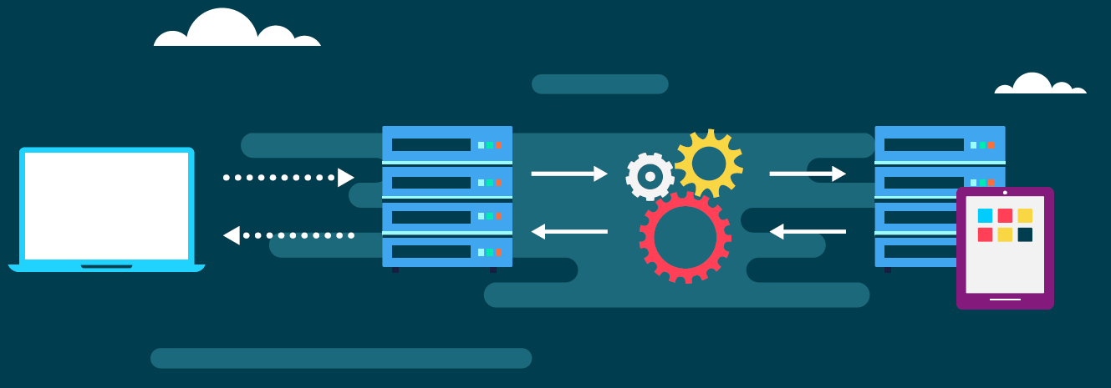
Server-side processing
Server-side processing allows dynamic page creation
We have a disconnected, document rendering model
That has become a distributed application development model
This has gone way beyond the original vision for the Web
16
Notes:
As with everything, the novelty of the Web soon wore off and people looked to extend it to more than a simple document publishing system. Since many businesses had massive amounts of data stored in enterprise databases, it made little sense to create web pages from these data by hand.
Instead it made a lot more sense to dynamically generate the Web pages from the database. One option was the overnight batch process but this was clearly only a stopgap solution. It is much better to create pages dynamically as the HTTP request comes in, and for this to happen you need to execute code to process the request.
If the server is going to run a program to process the request dynamically, why not go one better and let the created page depend on user input? With this in mind, we needed to be able to allow the user to enter data into the web page. Then when they submit their request to the server, it can process that submitted data and provide a personalised response. Consequently HTML forms were invented.

Slide 17
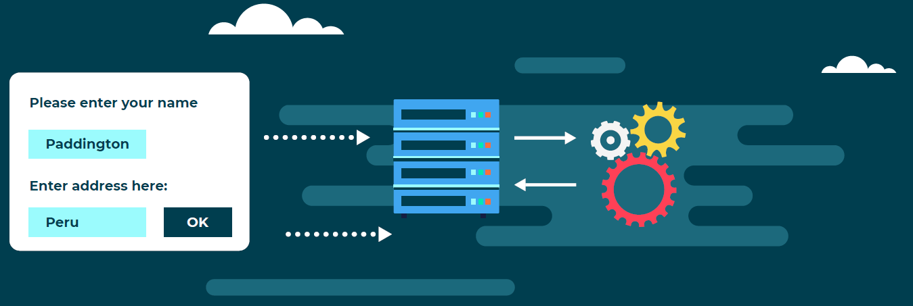
Forms and Server-side processing
Forms allow us to send data to the server for processing
Define:
Form – action & method
Inputs – name, type & value
We will investigate how exactly Forms work later on.
17
Notes:
An HTML form allows us to gather information from the user (using various input types) and send those values back to server with the next request.
The URL that is going to process those data is found in the action attribute of the form element.
The method dictates how we will send the data to the server.

Slide 18
Form methods
Form data can be submitted by HTTP GET or POST
GET places data in the QueryString portion of the URL
Can be bookmarked
Limited in length
POST places data in the body of the HTTP Request
'Hidden from view'
Unlimited length
GET /customer/create?Name=Paddington&Address=Peru HTTP/1.0 User-agent: Mozilla/4.0
GET /customer/newcustomer.aspx?Name=Paddington&Address=Peru HTTP/1.0 User-agent: Mozilla/4.0
POST /customer/create HTTP/1.0 User-agent: Mozilla/4.0 Content-type: application/x-www-form-urlencoded Content-length: 28
Name=Paddington&Address=Peru
POST /customer/newcustomer.aspx HTTP/1.0 User-agent: Mozilla/4.0 Content-type: application/x-www-form-urlencoded Content-length: 28
Name=Paddington&Address=Peru
Notes:
There are two methods that can be used to submit HTML form data:
GET
If the method on a form is GET then the data is sent in the QueryString portion of the URL. This is limited in length but can be bookmarked – which can be a good or bad thing. The data is also clearly visible and so can easily be tampered with.
POST
If the POST method is used then the data is “hidden” from the user – it can still be tampered with but this is far more difficult. It is also unlimited in length and is sent as the body of the HTTP Request.

Slide 19
Cookies
Data sent between Web server and browser
Server creates cookie, and initialises its name and value fields
Browser sends cookie back in each applicable request
GET ... HTTP/1.0 User-agent: …
HTTP/1.0 200 OK Server: Microsoft Set-Cookie: UID=123;...
GET ... HTTP/1.0 User-agent: … Cookie: UID=123
name
value
expires
domain
path
secure
Notes:
Cookies are small pieces of data, passed in the HTTP header. They are initially generated on the server and are sent back to the client as part of a response to some request. Thereafter, the client will pass the cookie back to the server during subsequent requests.
The data in a cookie is held as name/value pairs, where the value can be any textual data you like up to a maximum of four kilobytes. Cookies are not sent to the server with every request; exactly when the cookie is sent back to the server is subject to the following conditions, which are set by the server:
The domain with which the cookie is associated (see note below)
The path on the server under which the resource must reside.
The length of time until the cookie expires.
If the cookie can only be passed back over an HTTPS link.
Note: www.bbc.co.uk can set a cookie to the bbc.co.uk domain so that it could also be sent back with requests to news.bbc.co.uk, but they can’t set the domain of the cookie to sky.co.uk.

Slide 20

Internet Information Server (IIS)
Microsoft's enterprise Web Server is IIS
Managed through Internet Services Manager
Control panel | | Internet Information Services
Web pages stored in folder on the Web server (IIS)
Static and dynamic pages
Virtual directories
Allow folders to reside outside the IIS root folder
May be located on different drives / partitions
Set the folder as an IIS Application area
Can be isolated from other applications
Notes:
Internet Information Server (IIS) is Microsoft’s enterprise Web Server solution. Windows Server 2003 came with IIS6, in Windows Server 2008 there is a new version, IIS7, that integrates completely with ASP.NET.
Both of these are managed through Internet Services Manager, although the user interfaces are very different.
Web pages (and supporting files) are stored in a directory on the Web Server – these include all the static and dynamic files required for the Web site.
IIS allows for the creation of a Virtual Directory that points to this directory but IIS will expose this to the user with a well-known HTTP address.
In order for ASP.NET to function within a Virtual Directory it is necessary to ensure that the Virtual Directory is set as an application.
In both IIS6 and IIS7 there are Application Pools that allow isolation, among other things. These are the process spaces in which the ASP.NET applications will run.

Slide 21
In this chapter you investigated:
The history of Web-based development
The role of Internet Information Services – IIS
You also learned about
The World Wide Web
HTTP protocol
Cookies
Forms
Summary

Slide 22
LAB
In this lab you will take a deep dive into how information is requested and received
Please start the "Web Application Architectures" lab
30 minutes
Notes:
All slides titled ‘Lab’ (Normally the last slide in the deck).

